Slide 1

Sui 101 Introduction to Sui
Audience: Students, Web2 Devs, Crypto Curious

Slide 2

Learning Objective
Understands the basics of Sui and blockchain
Set up a Sui wallet to interact with the network
Mint an NFT on the Sui blockchain

Slide 3

What is a blockchain?
Distributed ledger technology
Immutable and transparent record-keeping
Transactions stored across a network of computers

Slide 4
What is Sui?
A high-performance Layer 1 blockchain focused on speed and scalability
Centered around assets and objects
Uses the Move programming language

Slide 5

How is Sui Different?
Object-Centric Model
Assets on the Sui blockchain are called objects
Each object has a unique ID and can store data or be modified
This model is different from account-based blockchains

Slide 6
Intro to Move Language and Sui CLI
Move language is a safe and flexible smart contract programming language
Sui CLI is a command-line tool for interacting with the Sui network

Slide 7
Basic Transactions:
Mint an NFT, Send Tokens
Mint a simple NFT on Sui testnet
Transfer tokens to another wallet

Slide 8

Quiz + Hands-On Challenge
Mini Quiz
Challenge
What is Sui’s object model?
How is Move different from Solidity?
Deploy an NFT smart contract
Mint NFT by calling smart contract function
Screenshot & Submit

Slide 9

Summary
Resources
What blockchain is and how Sui works
How Sui’s object-centric model is unique
Basic wallet setup, Move, and transactions
docs.sui.io
Sui Wallet
Sui Developer Forum

Slide 10



Set up you Slush Wallet
Install Slush
Back Up Seed Phrase
Get Sui from Faucet

Slide 11
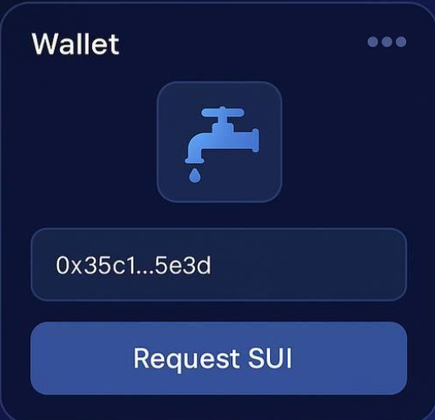
Get SUI from the Faucet
Go to a Sui testnet faucet site
Paste your address
Request testnet tokens

Slide 12
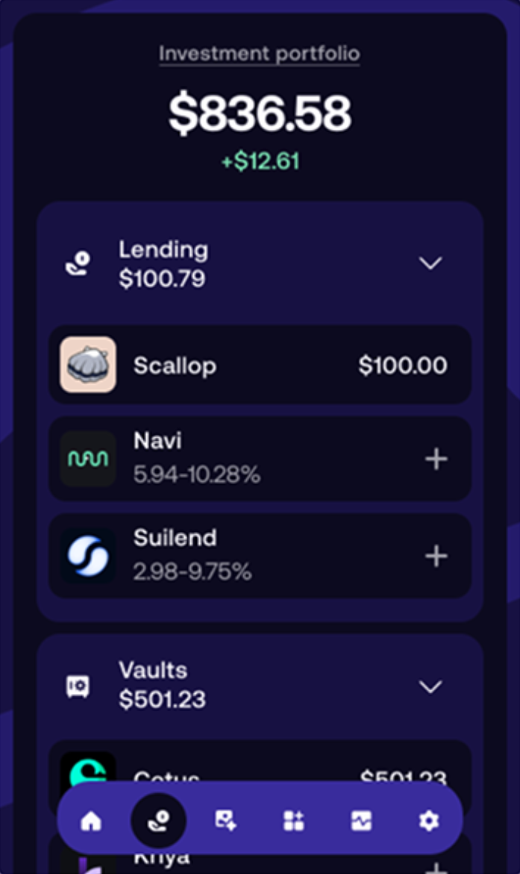
Explore Your Wallet Interface
1
Token balance in SUI
Minted NFT collections
2

Slide 13

Install Sui CLI
macOS
brew install sui
Windows
Winget install sui
Linux
0 ALTER

Slide 14
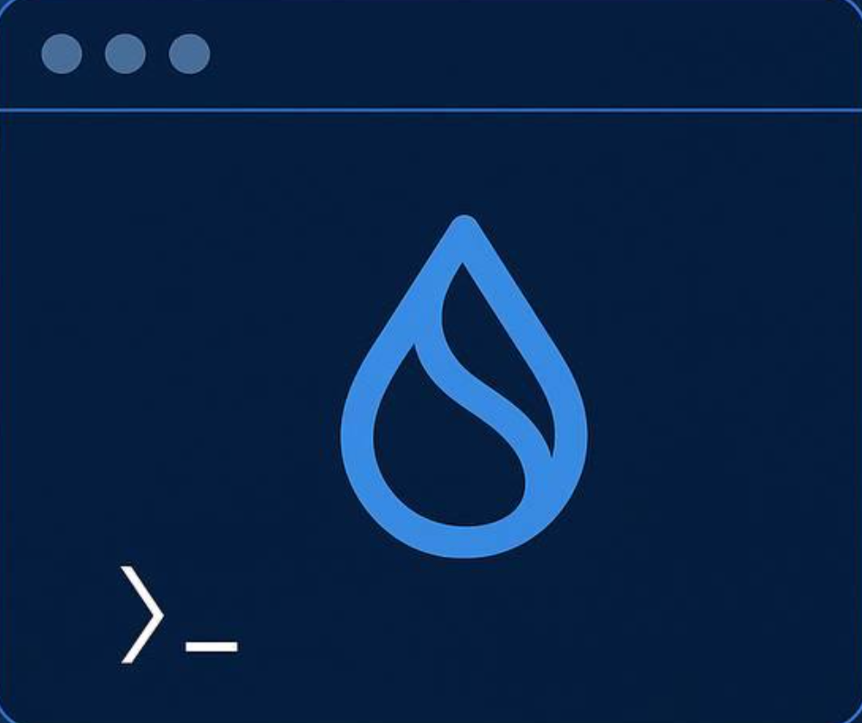
CLI Command Walkthrough
Sui client new-address
1
Sui client transfer-sui
2
3
Sui client call

Slide 15
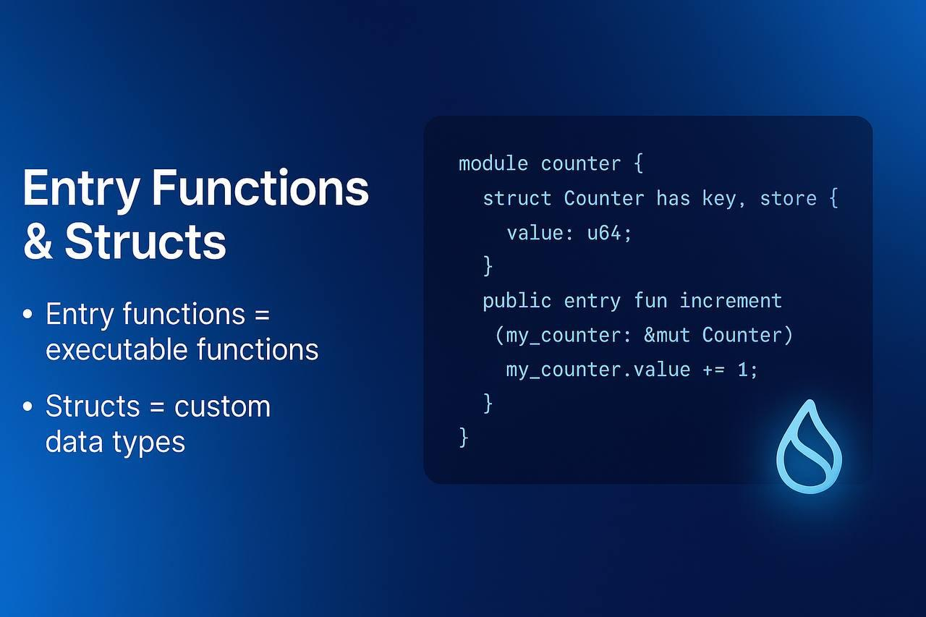
Entry Functions & Structs
Module counter {
Struct Counter has key, store {
value: u64:
}
public entry fun increment
(my_counter: &mut Counter)
my_counter.value += 1;
}
}
Entry functions = executable functions
Structs = custom data types

Slide 16
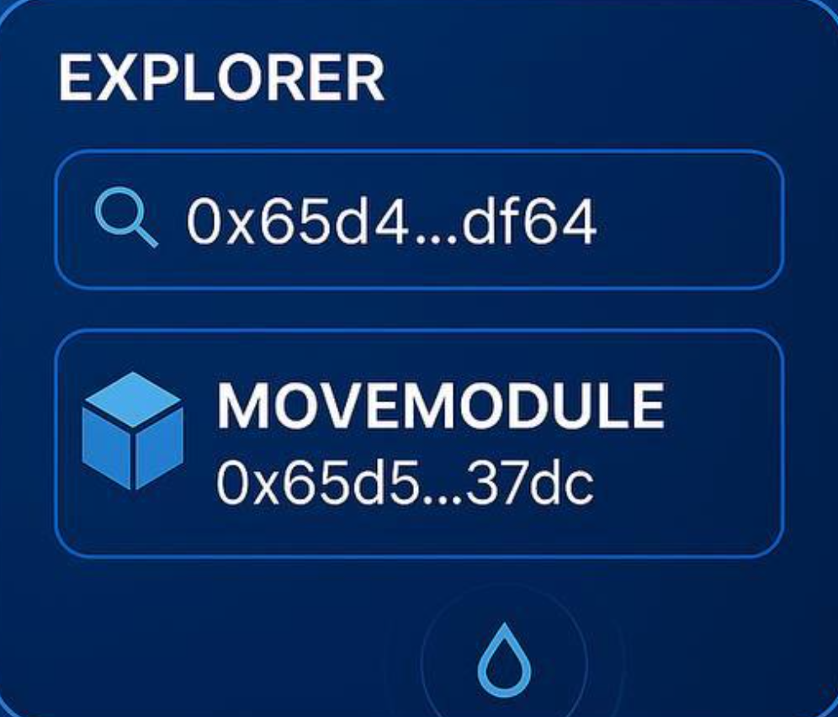
View Your Module
Go to Sui Explorer https://suiscan.xyz/mainnet/home
Search for your Move module

Slide 17
Top Student Questions
What is the Sui wallet recovery process?
How do I connect my Sui wallet to dApps?
Where can I find more resources on Move?
Is this course really beginner-friendly?

Slide 18
Next: Builder Track Preview
Focus on writing and deploying contracts
Understanding gas and storage

Slide 19
Thank You.

